Slide 1
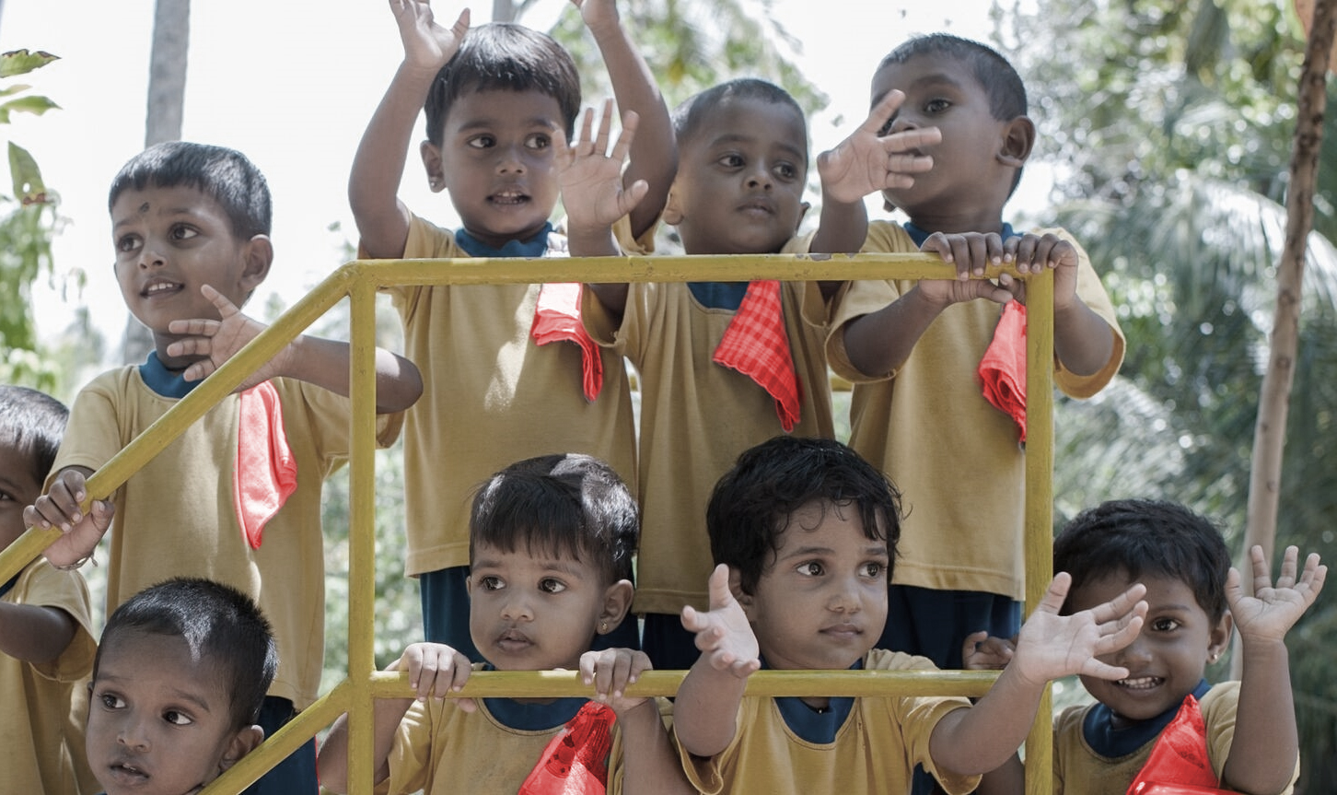

Slide 2
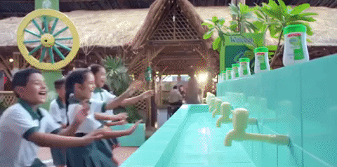
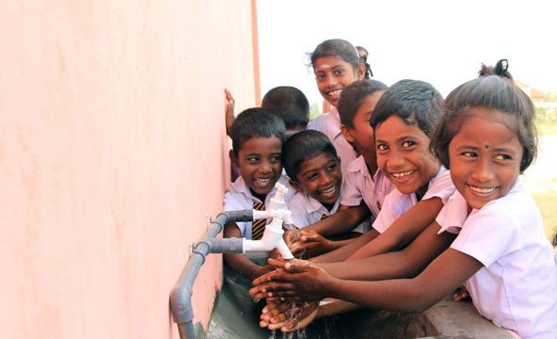
EXPECTATION
REALITY
vs

Slide 3
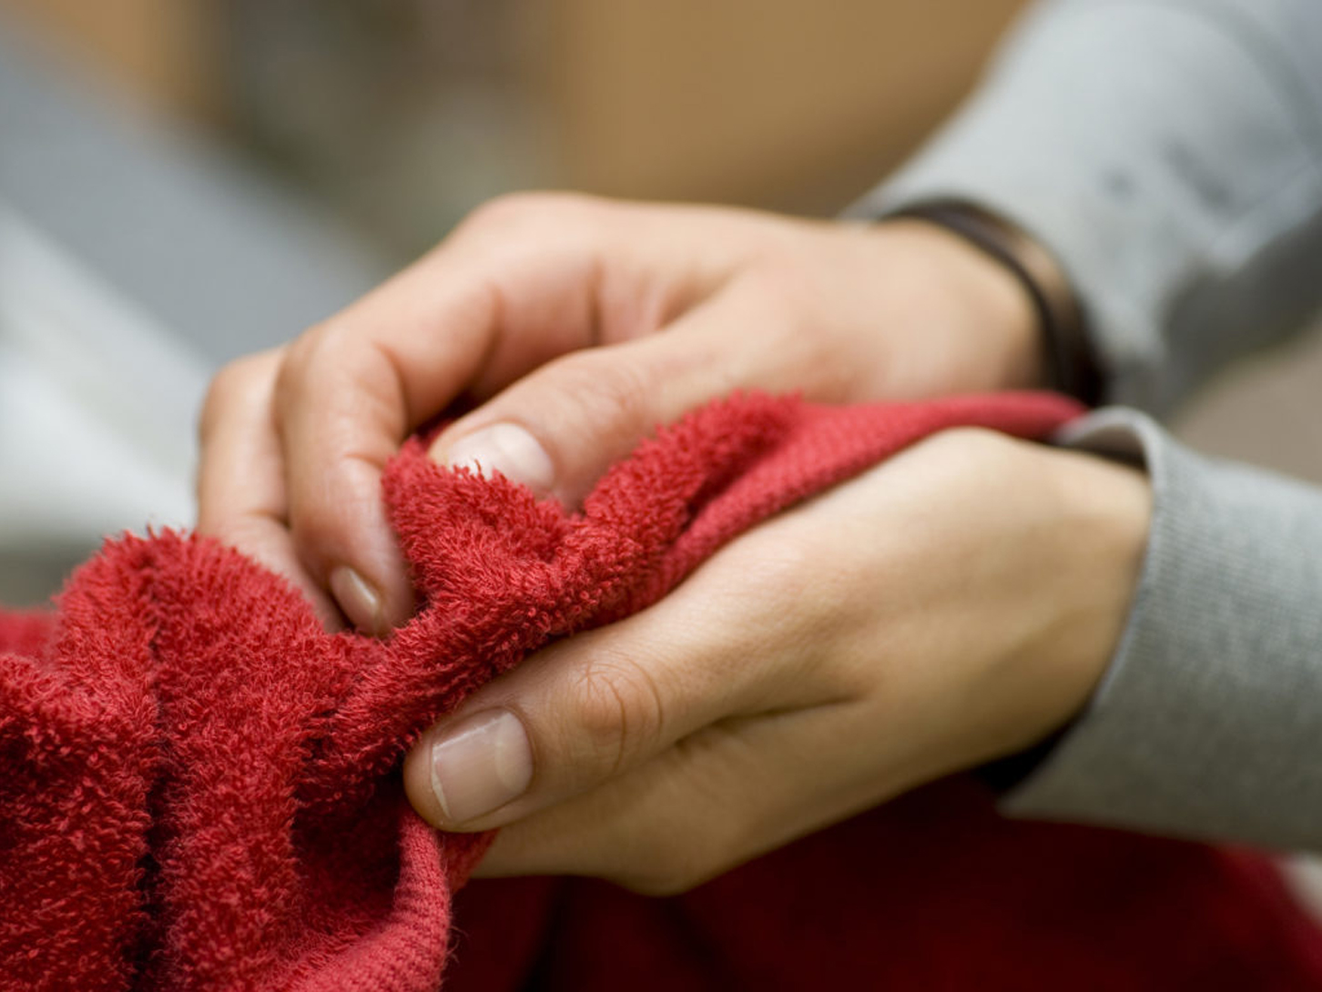
THE BENEFIT OF WASHING HANDS
IS LOST BY DRYING HANDS
Public washrooms, even in school washrooms lack soap.
Sri Lankans use cloth/reusable napkins over disposable napkins

Slide 4
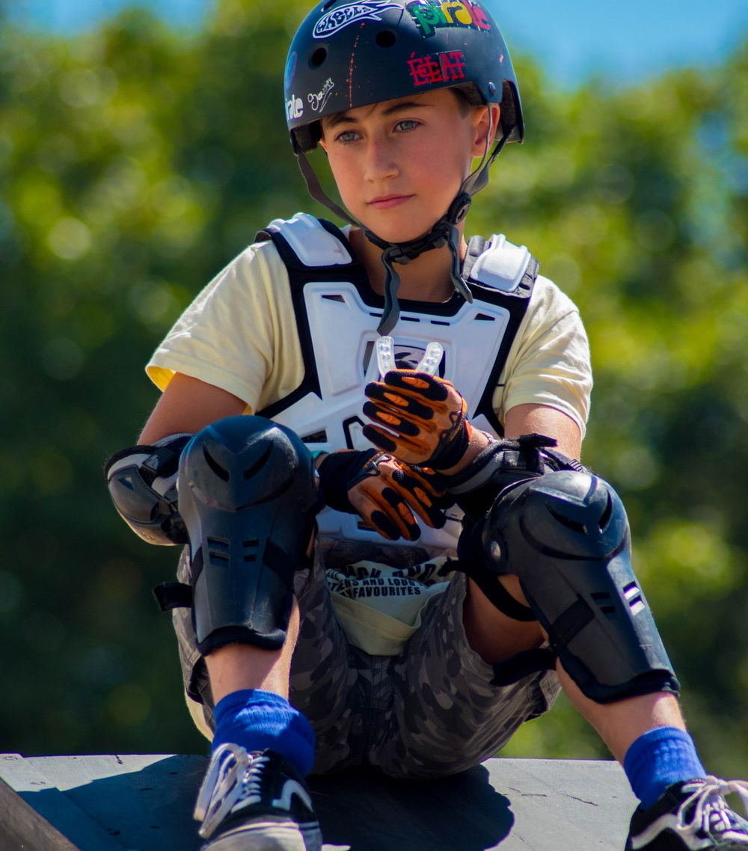
Rather than create another disposable product, we need to find a way to give the items we use every day the
“GOLD STANDARD OF GERM PROTECTION”
YOUR
TITLE HERE

Slide 5
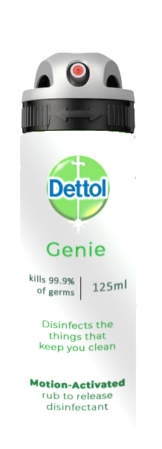
A DISINFECTING PRODUCT THAT ACTIVATES
NOT JUST ONCE,
BUT WHENEVER WE USE THE ITEM

Slide 6
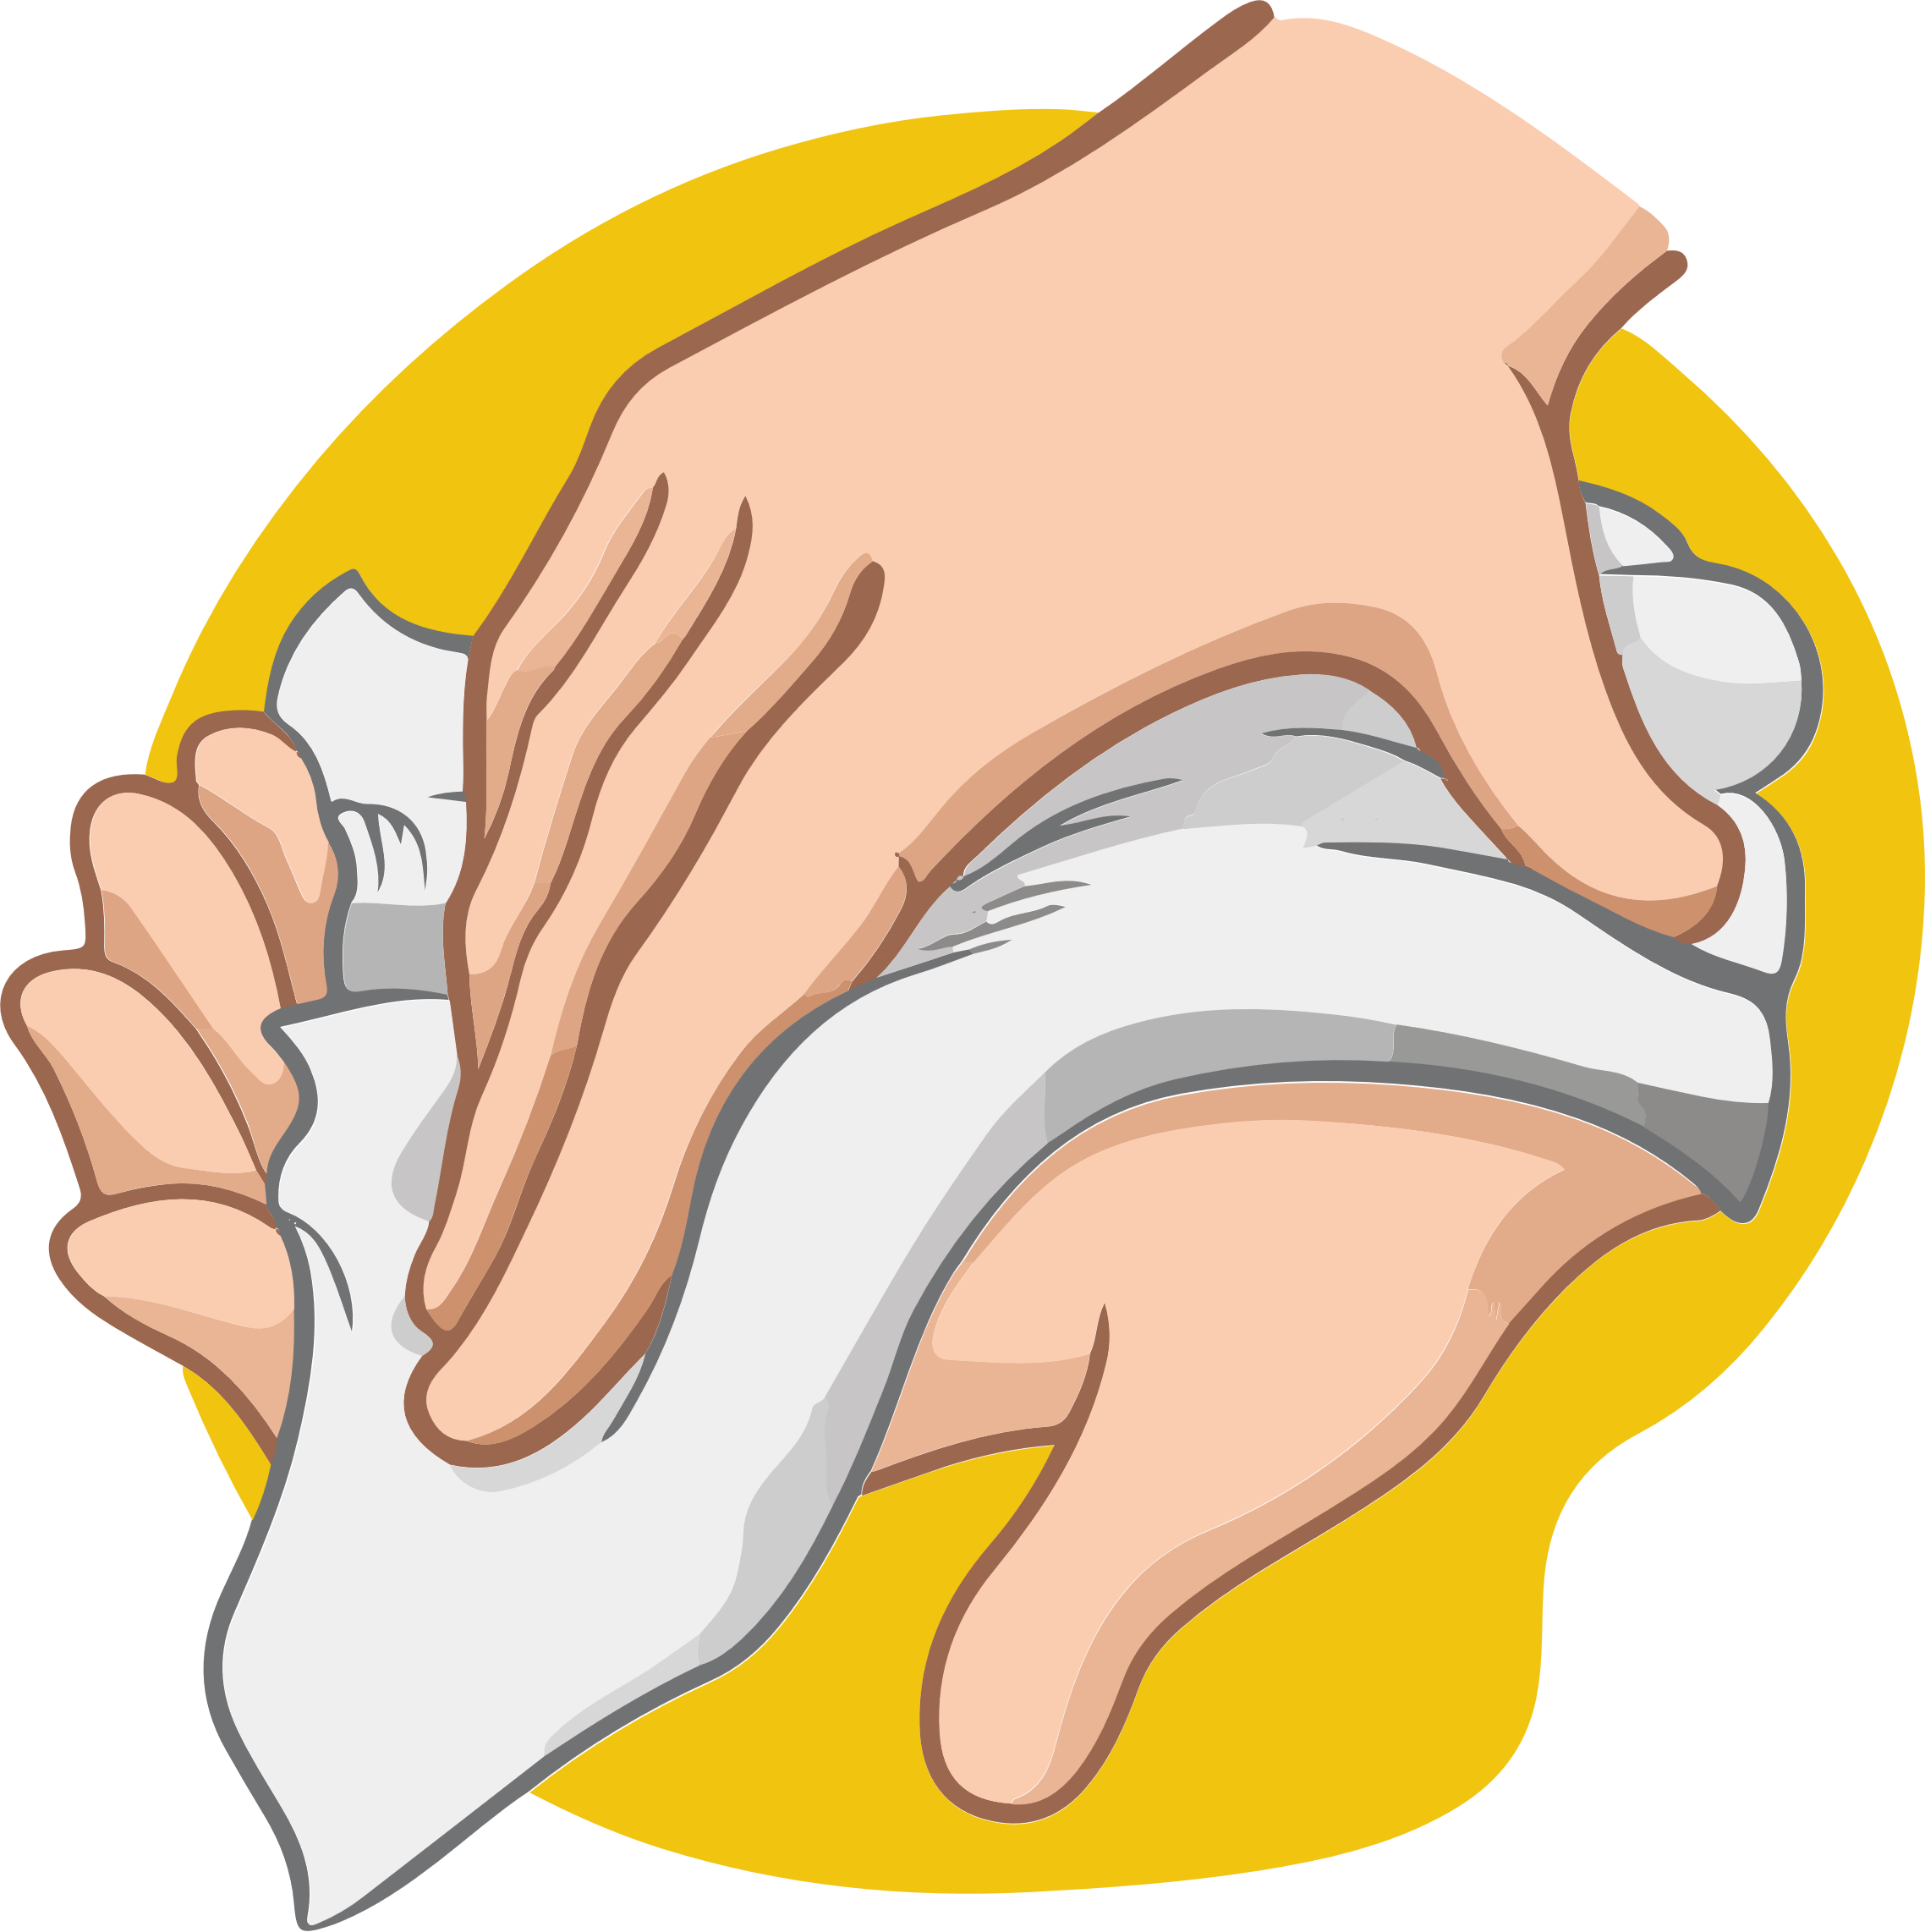
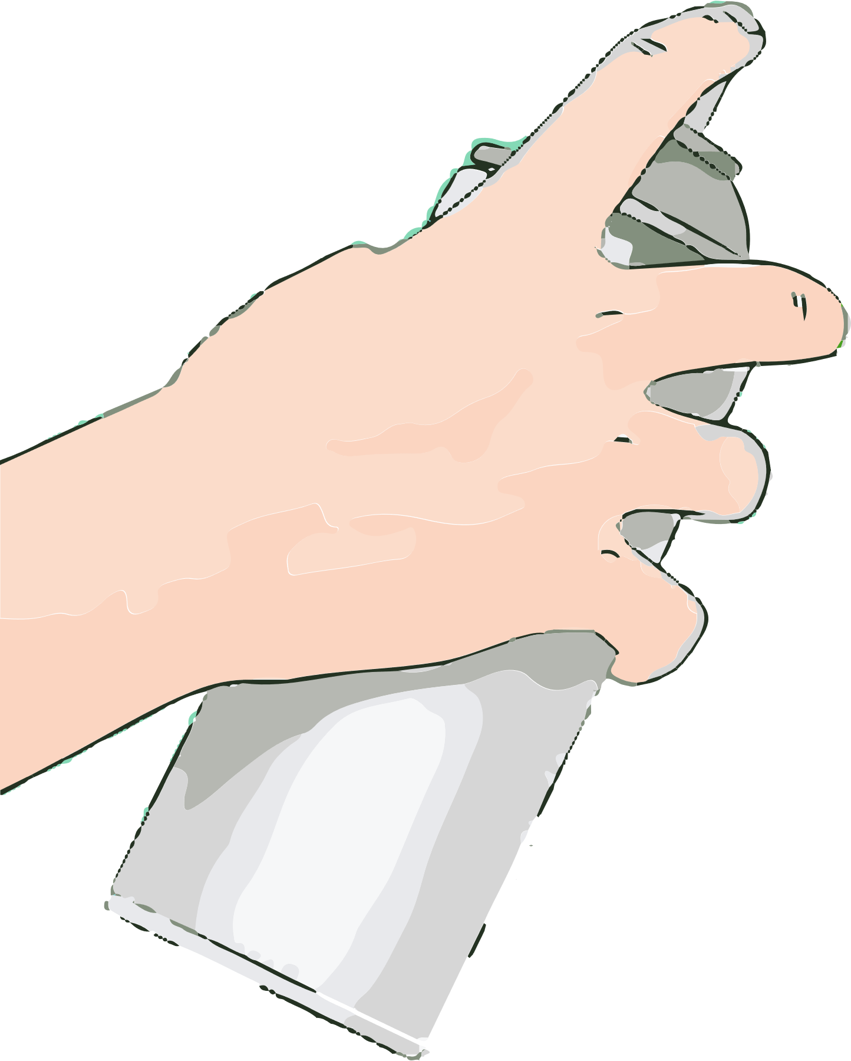
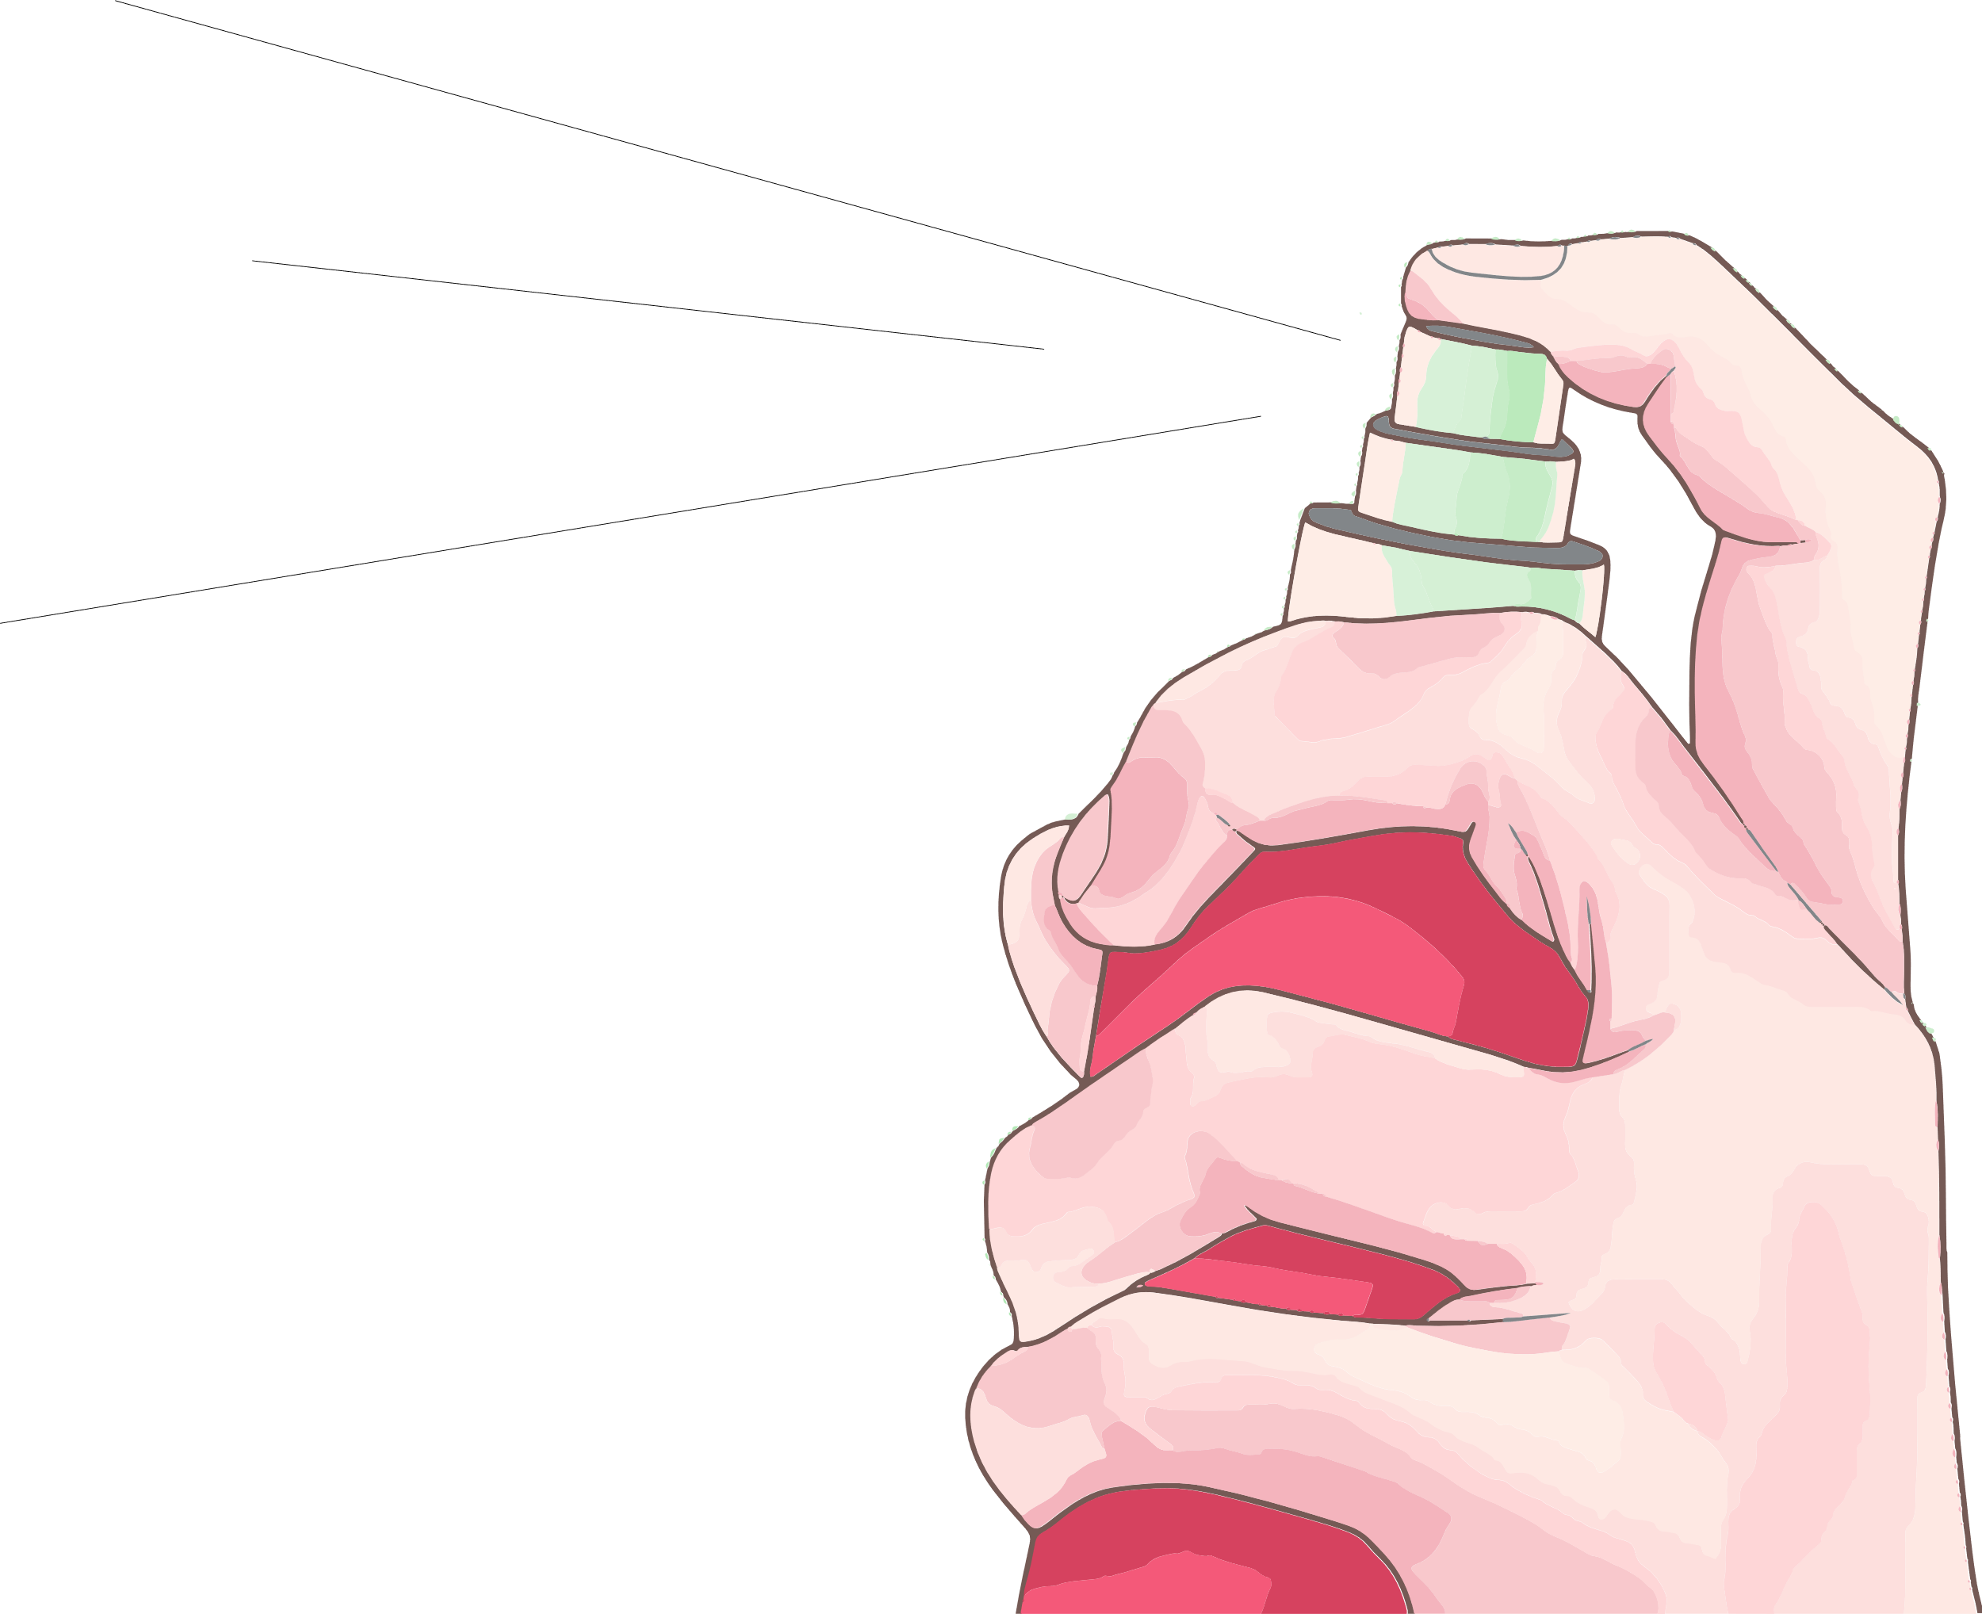



v
SPRAY
REPEAT
RUB

Slide 7
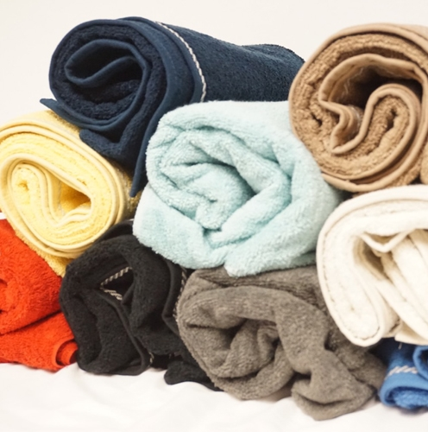
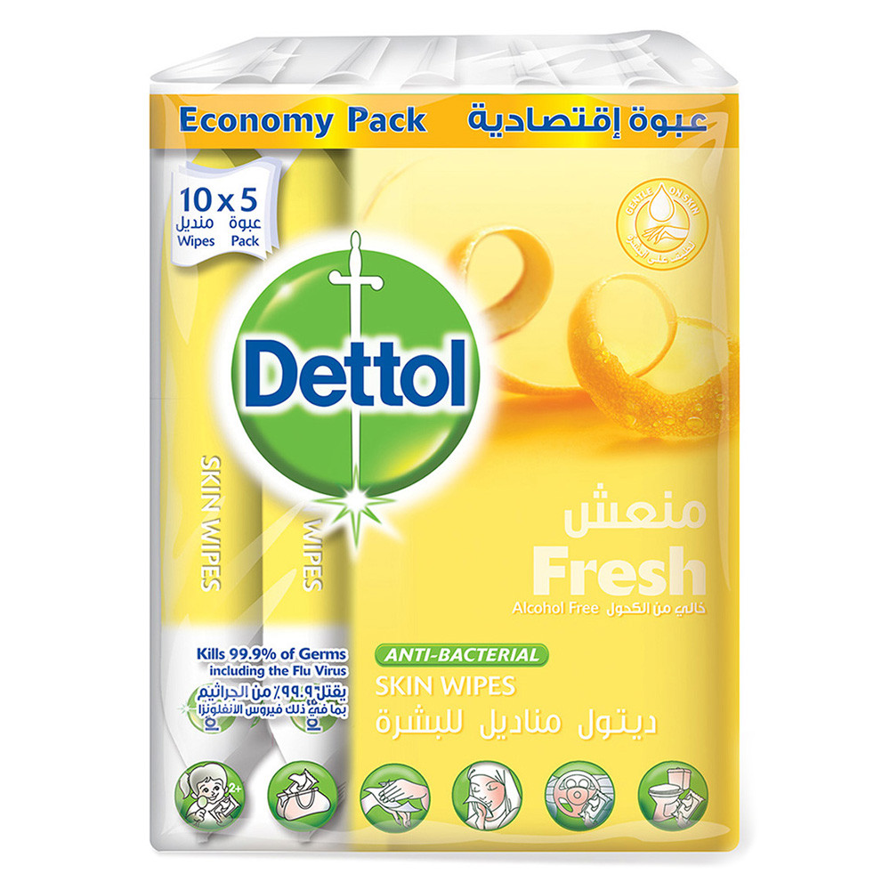
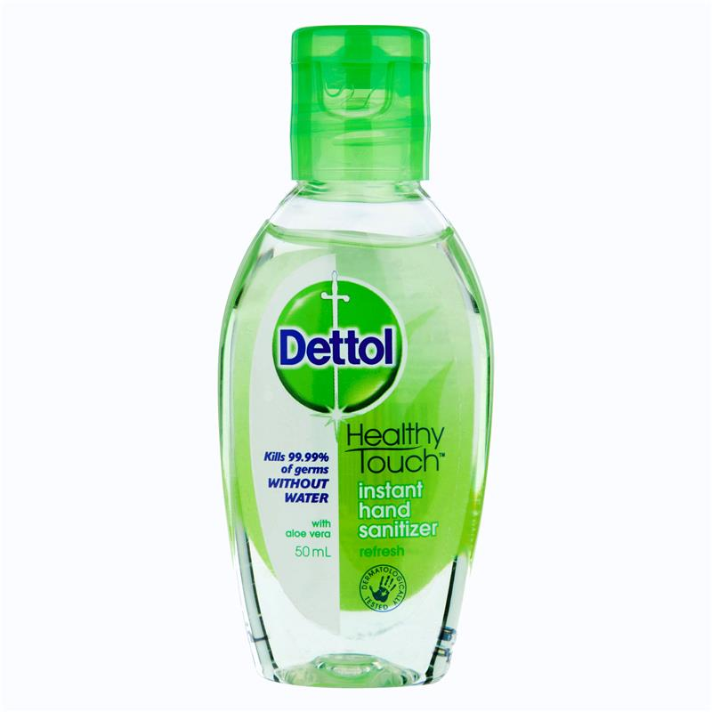
EXPECTATIONS
Waterless
Discreet and portable
Guarantee of cleanliness
GAP IN MARKET
No reusable disinfectant.
No product that cleans towels, handkerchiefs and keeps it clean.
BARRIERS
Convincing people that it works.
Staining
Skin friendliness
BUSINESS MODEL
Fits into the existing business model of RB

Slide 8
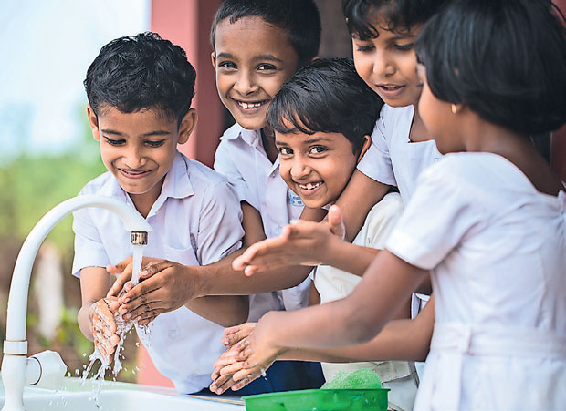
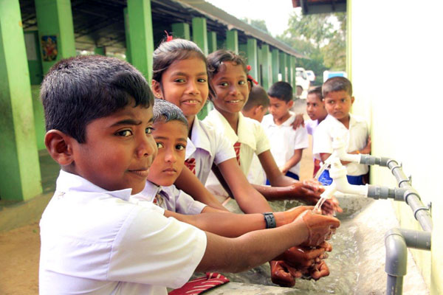

SEGMENTS
Moms with young kids
The on-the-move working crowd
POSITIONING
High standard of germ protection
Effective and reusable
STRATEGIC FIT
Disinfectant at all times
DEMOCRATIZING
THE GOLD STANDARD

Slide 9
OFFERING
PRODUCT
Motion activated disinfectant
PRICING
Rs 300 – 600
(125ml-250ml bottles)
4P
PLACEMENT
Supermarkets and Pharmacies,
Online
PACKAGING
Aerosol Spray for daily use/ Liquid for longer exposure

Slide 10



SUSTAINABLE
FMCG
EXPANDABLE

Slide 11
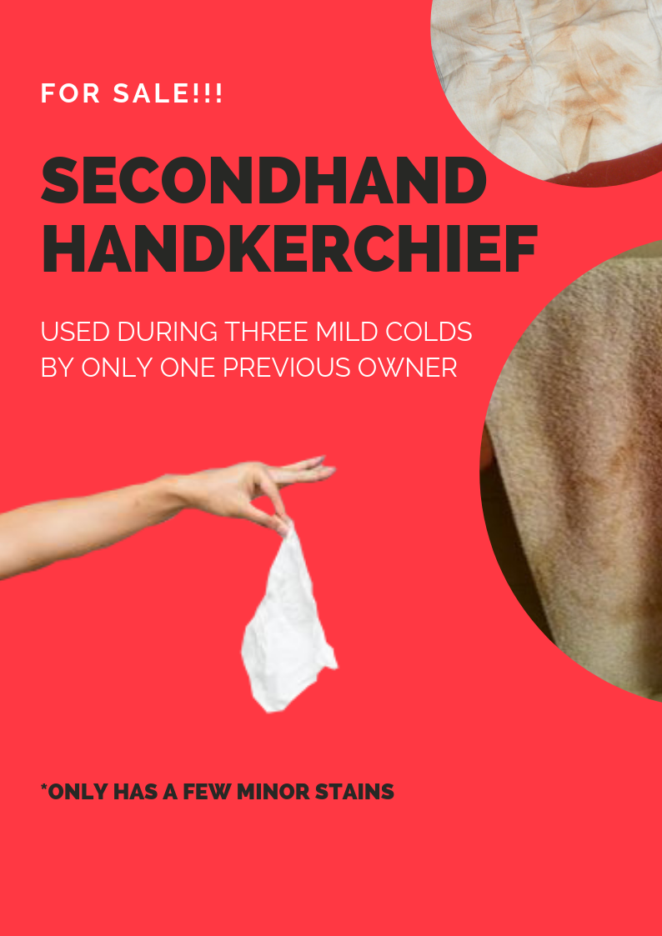
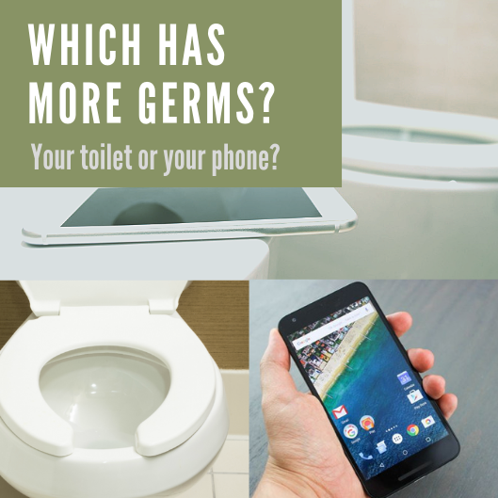
IS IT CLEAN?
Social media, YouTube and TVCs

Slide 12
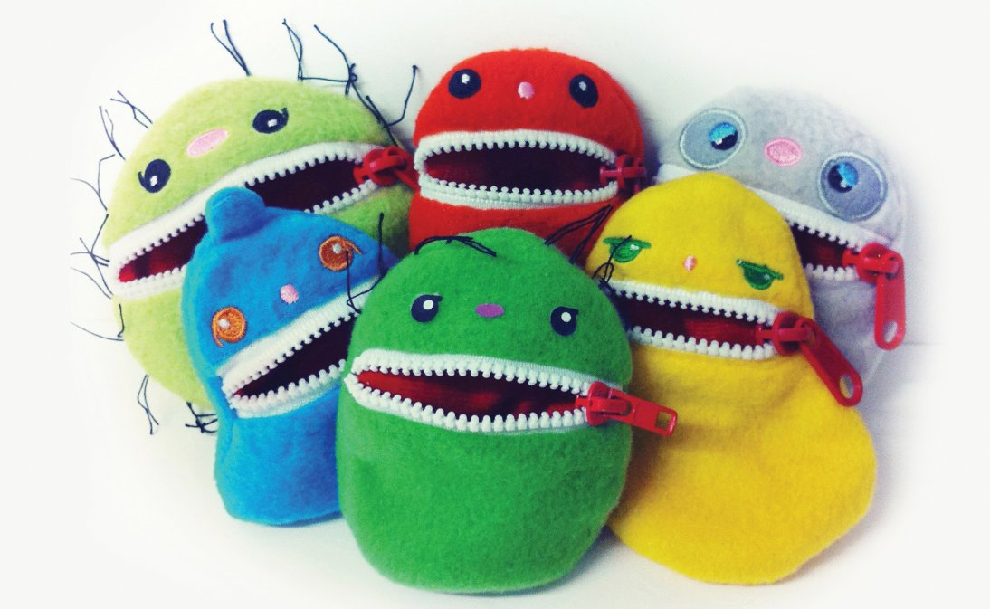
ARE YOUR CHILDREN SAFE AT HOME?
DETTOL PROTECTION WHERE EVER YOU GO
…AT SCHOOL?

Slide 13

 | 2019 | 2020 | 2021
COST OF GOODS SOLD | 11,700,000 | 7,896,600 | 120
VOLUME UNITS | 60,000 | 64,200 | 66,768
PRICE | 300 | 300 | 300
TOTAL SALES | 18,000,000 | 19,260,000 | 20,030,400
OVERHEAD | 4,851,000 | 8,408,916 | 8,773,315
NET REVENUE | 1,449,000 | 2,954,484 | 3,244,925
GROSS MARGIN % | 35 | 59 | 60
MARKETING AND DISTRIBUTION | 2,182,950 | 2,522,675 | 1,315,997
PC | 2,700,448.43 | 323,980.78 | (2,016,903.99)
ASSUMPTIONS
Operating Margin % | 23 | 26 | 27
Growth Rate % |  | 7 | 4
R&D | 4,000,000
ROI | 11.5%
Rs.

Slide 14
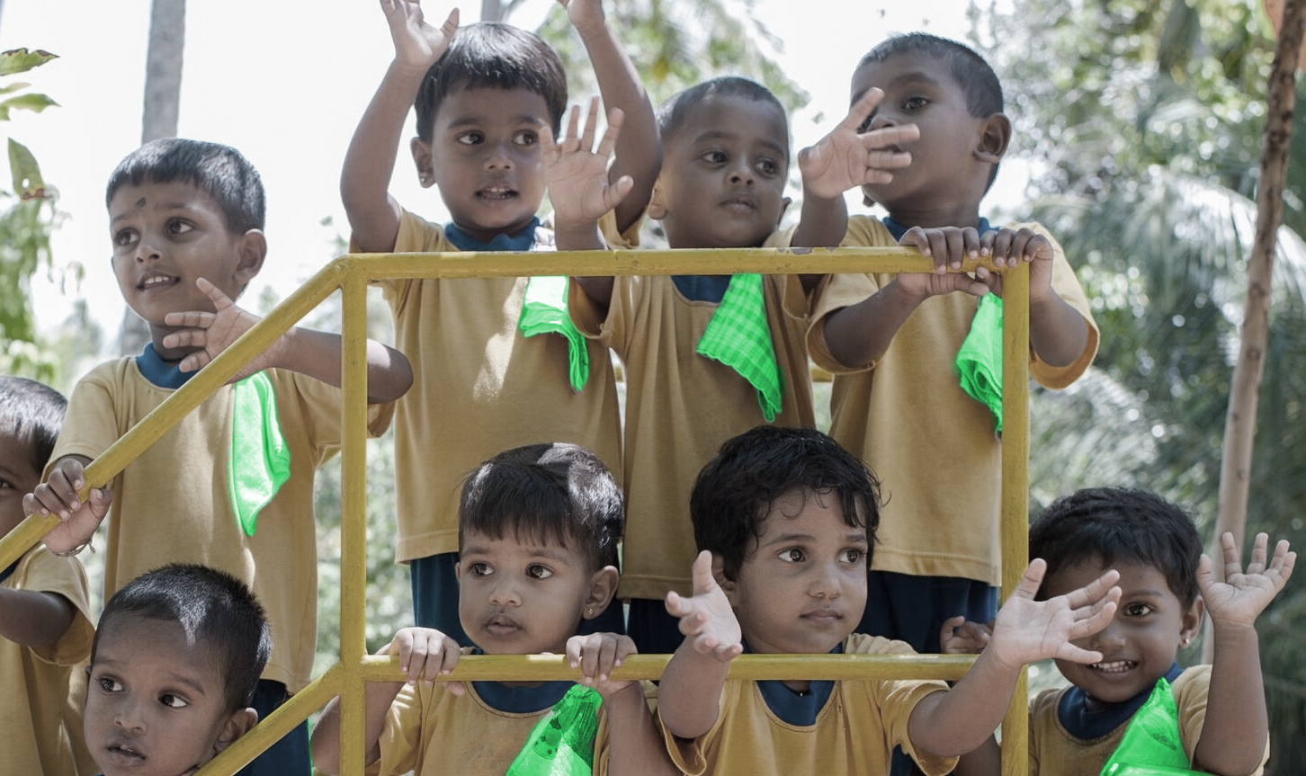
THANK YOU

